Slide 1
Assignment 2 SQL
By hatim

Slide 2
What is SQL
Stands for structed query language
In the most basic of terms it is a database management system
Used by data analyst and data scientist

Slide 3
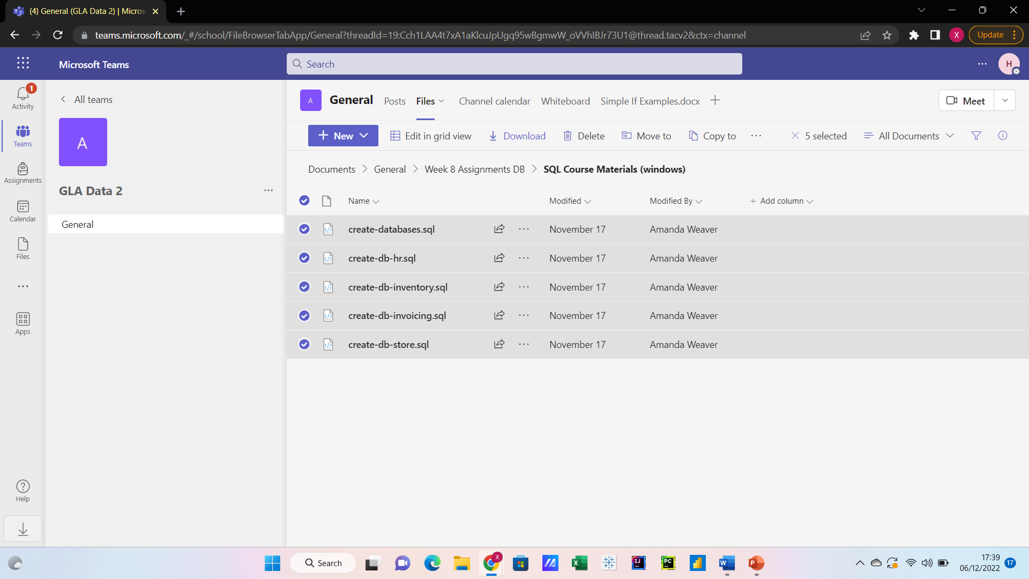
First we downloaded the correct files

Slide 4
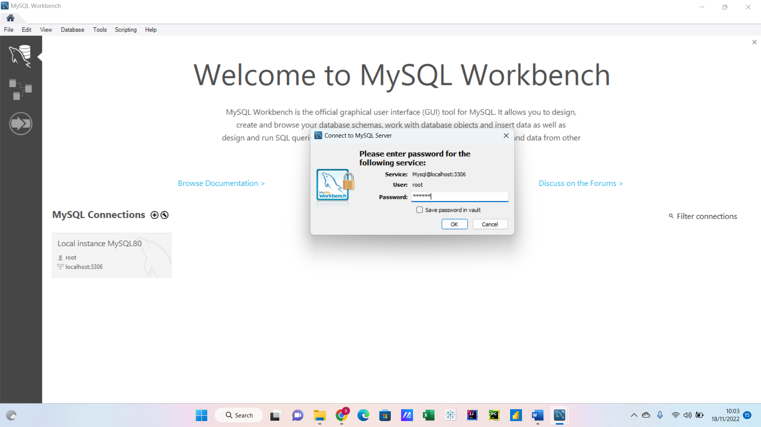
First we began by creating a specific password to our own individual sever

Slide 5
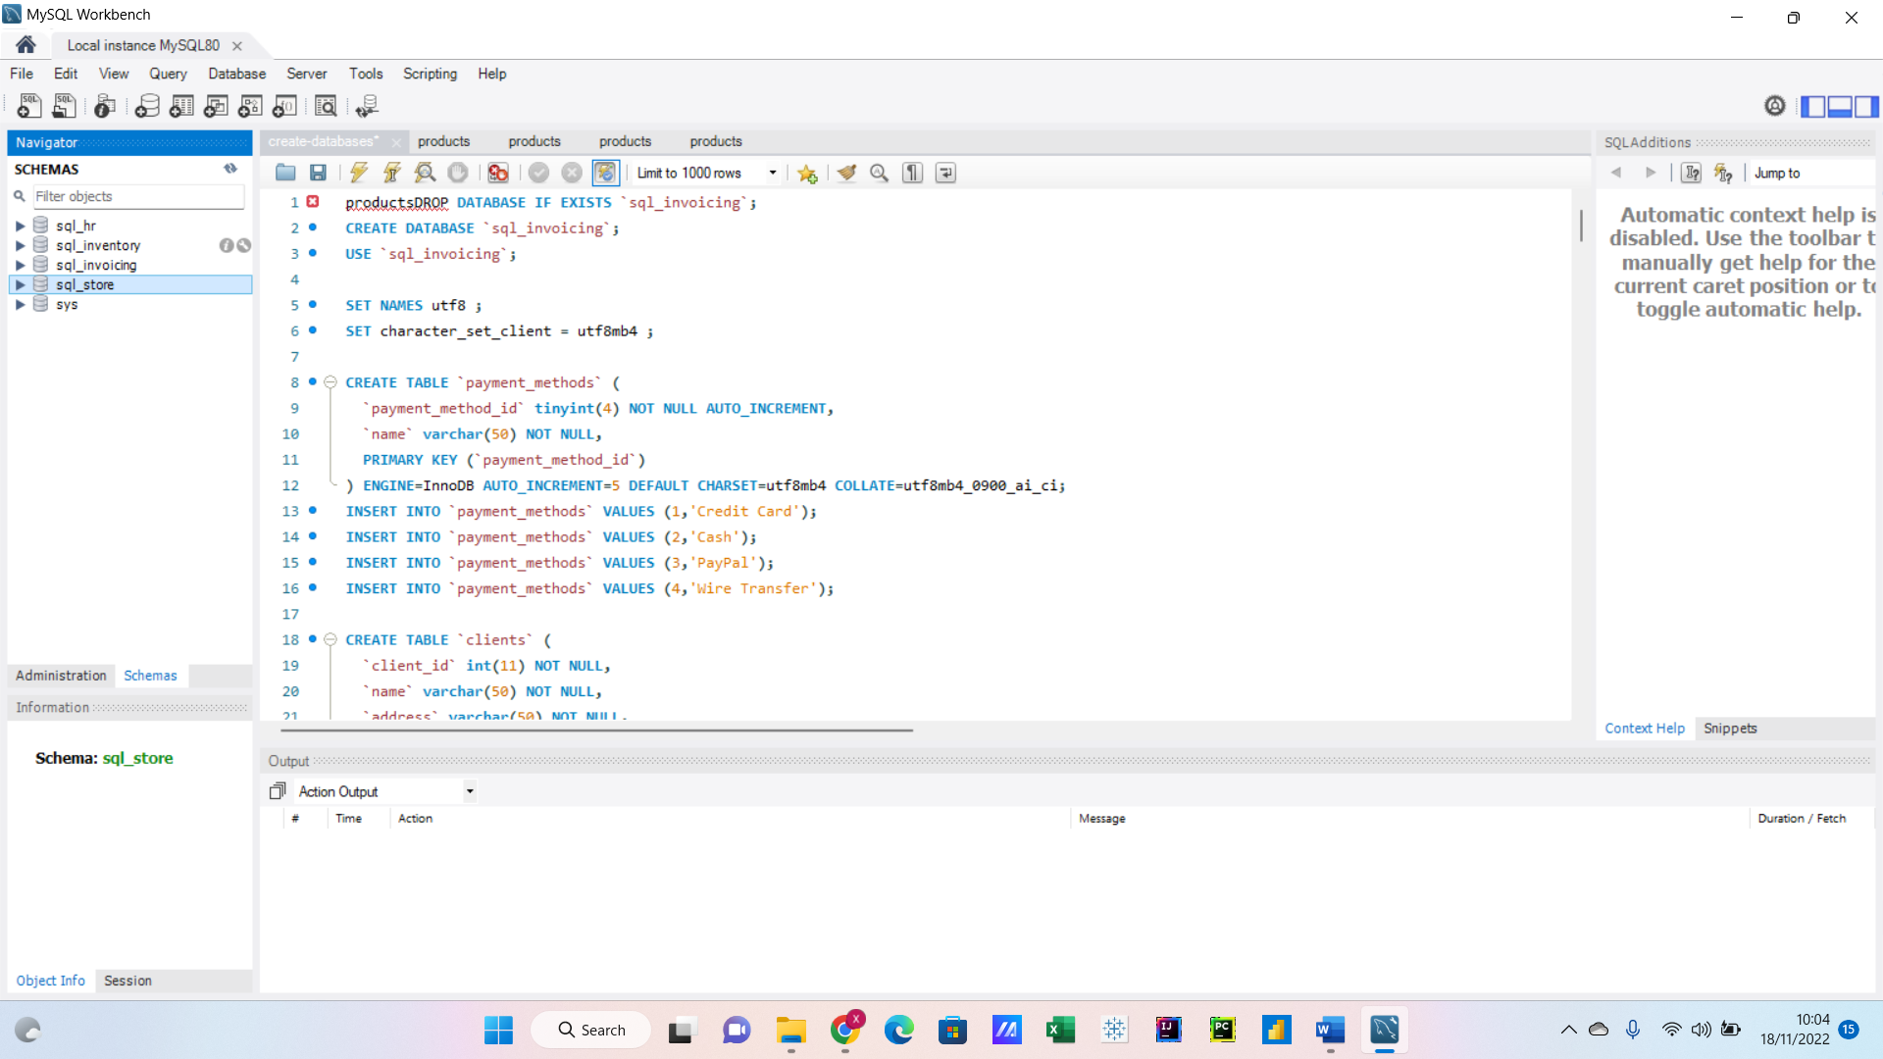
After downloading the parts of the assignment from the work folder

Slide 6
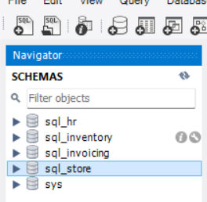
After executing the data only one part of the sever was loaded and ready to use and that was store

Slide 7
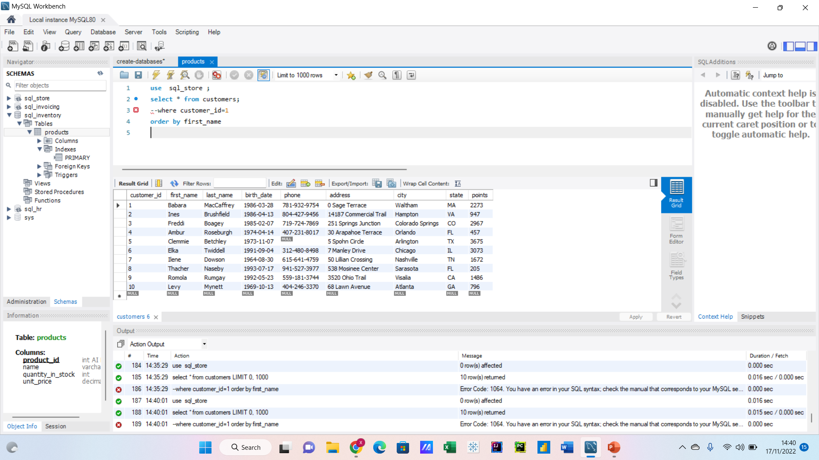
Using specific lines of code we where we are able to draw data from store and order the data by first name

Slide 8
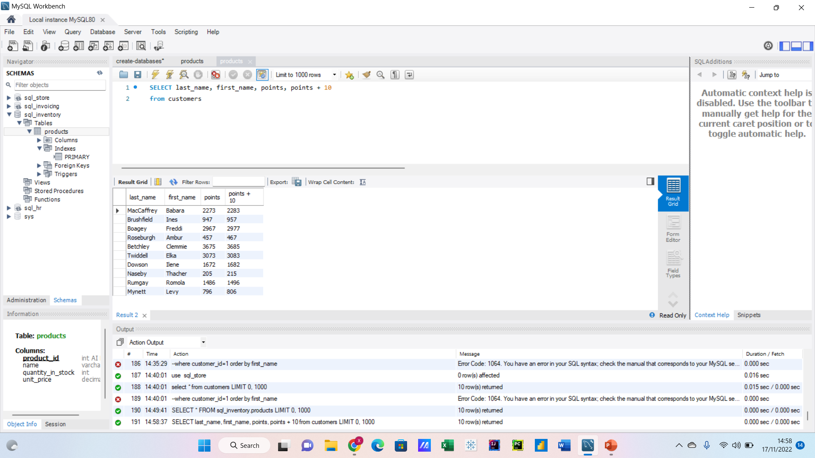
With this formula we manipulated the data using the point system to give an additional 10 points

Slide 9
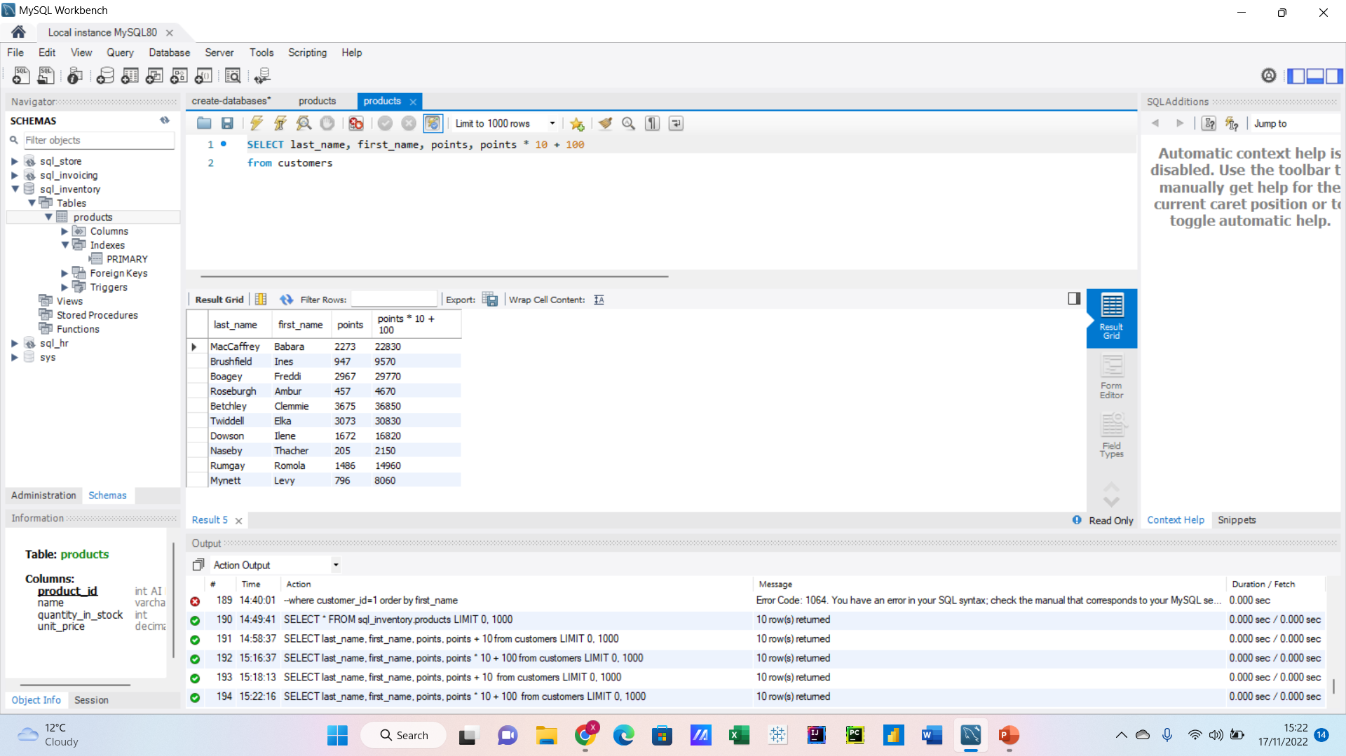
We then gave an additional 100 points

Slide 10
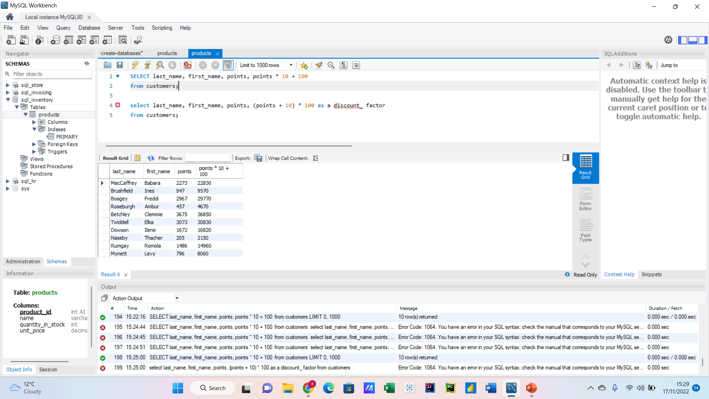
Using a real life example using the code we additional points or multiplied them

Slide 11
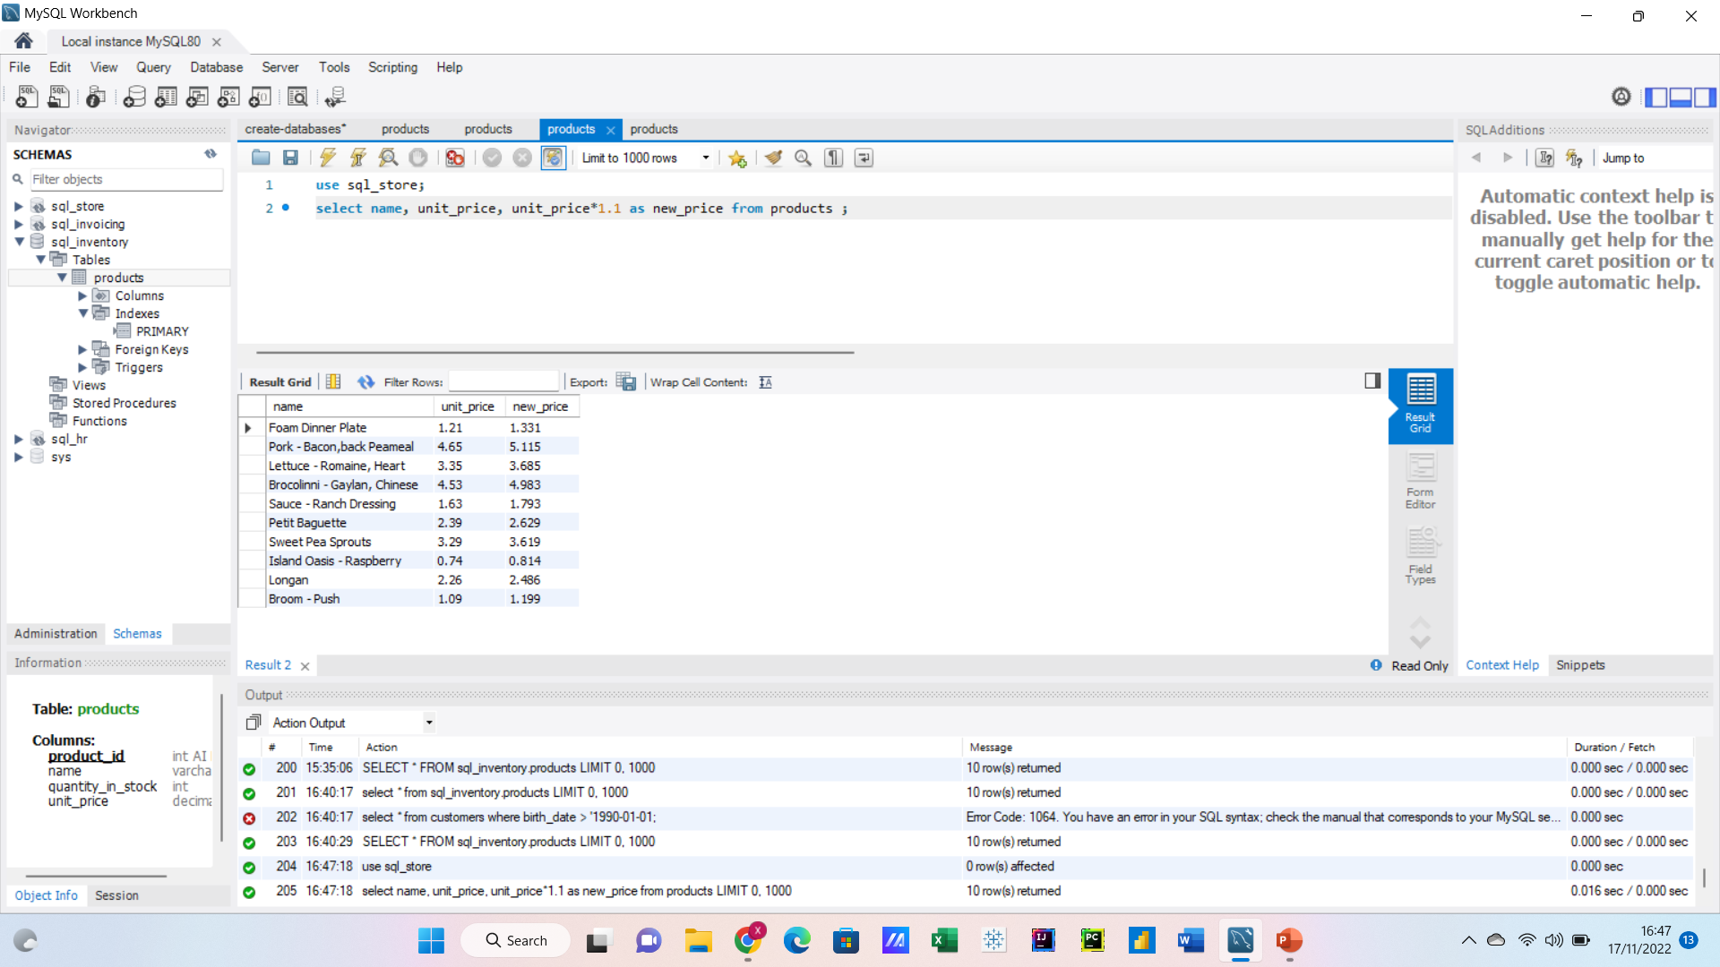
Now instead of using costomer we used items and changed the price

Slide 12
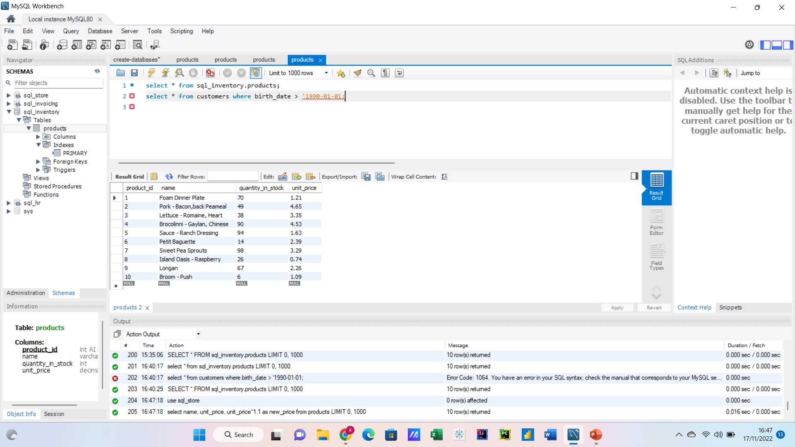
Using code we are able to draw data specifically using any parameters such as age

Slide 13
What is a schema
A database schema defines how data is organized within a relational database; it uses table names, fields, data types, and the creates a new format that show the relationships between the data

Slide 14
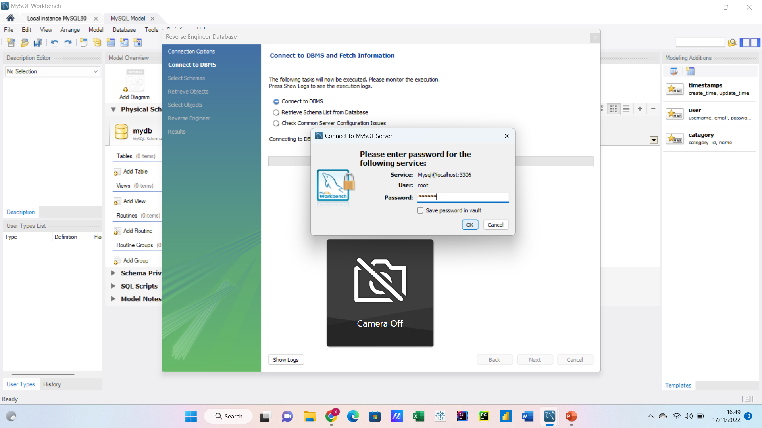

The following steps show how create a schema first we have to log into our personal server

Slide 15
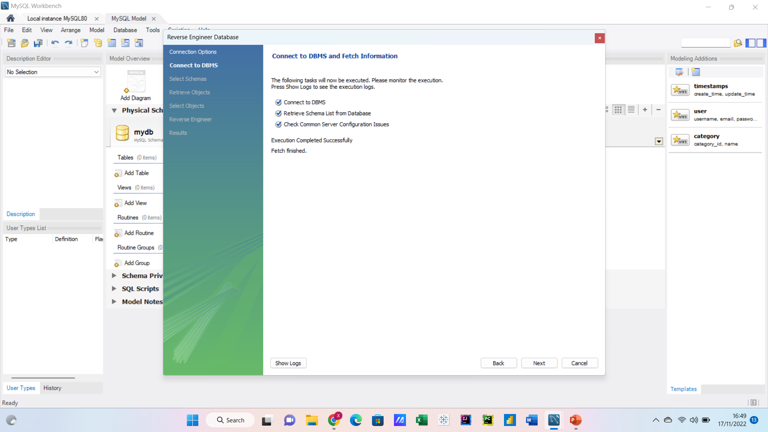
We select the appropriate settings

Slide 16
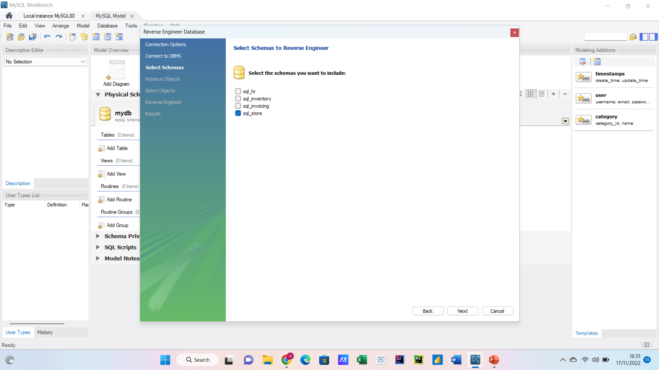
We select where want to draw the data from

Slide 17
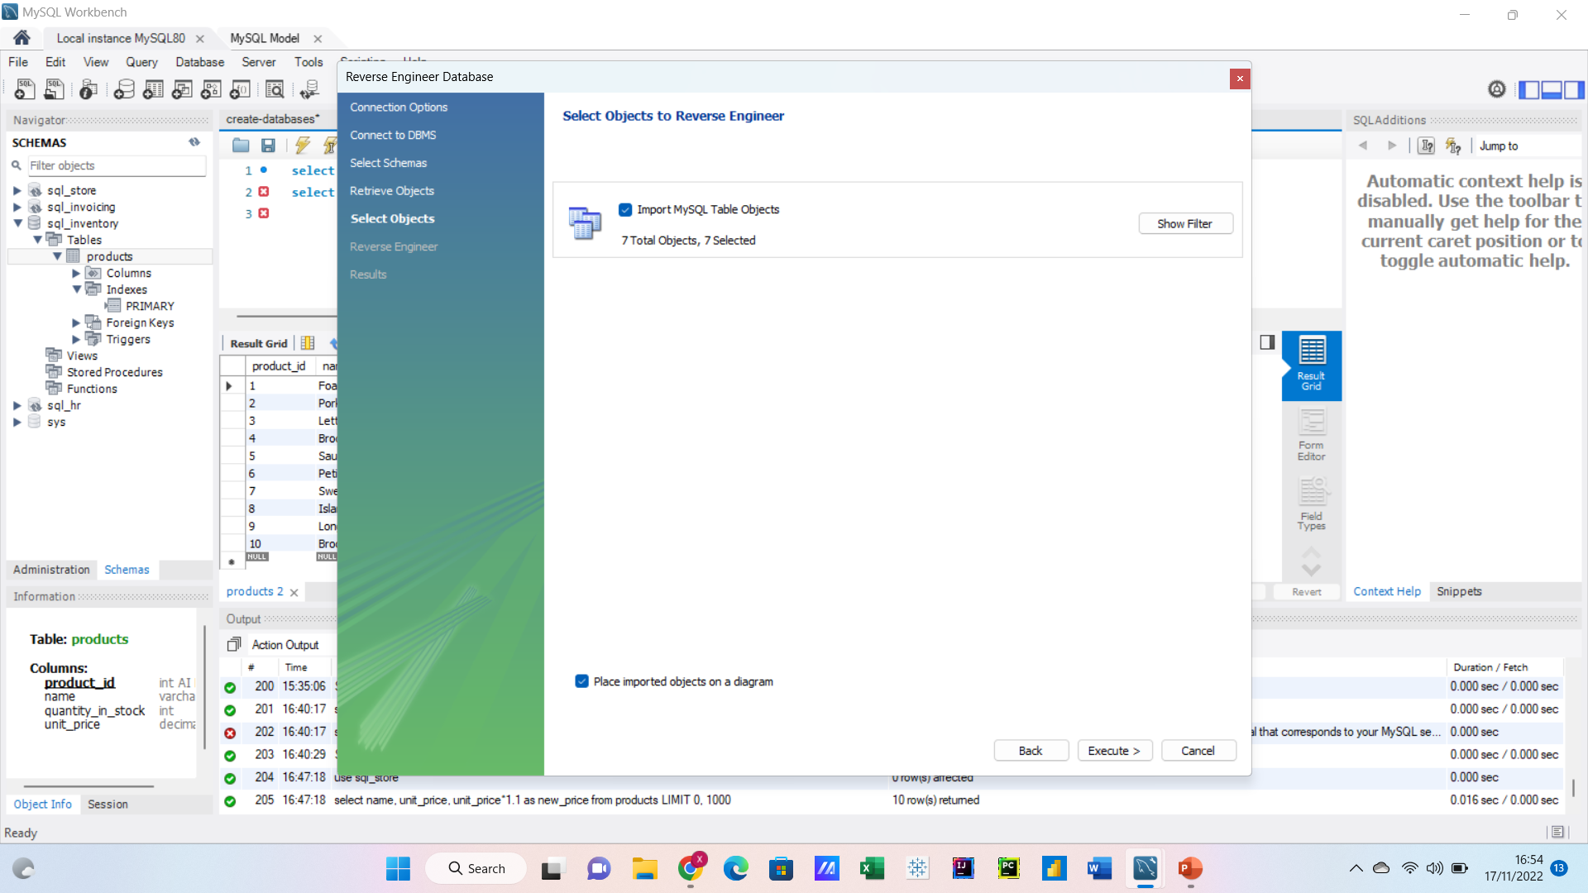
We wait for it to load

Slide 18
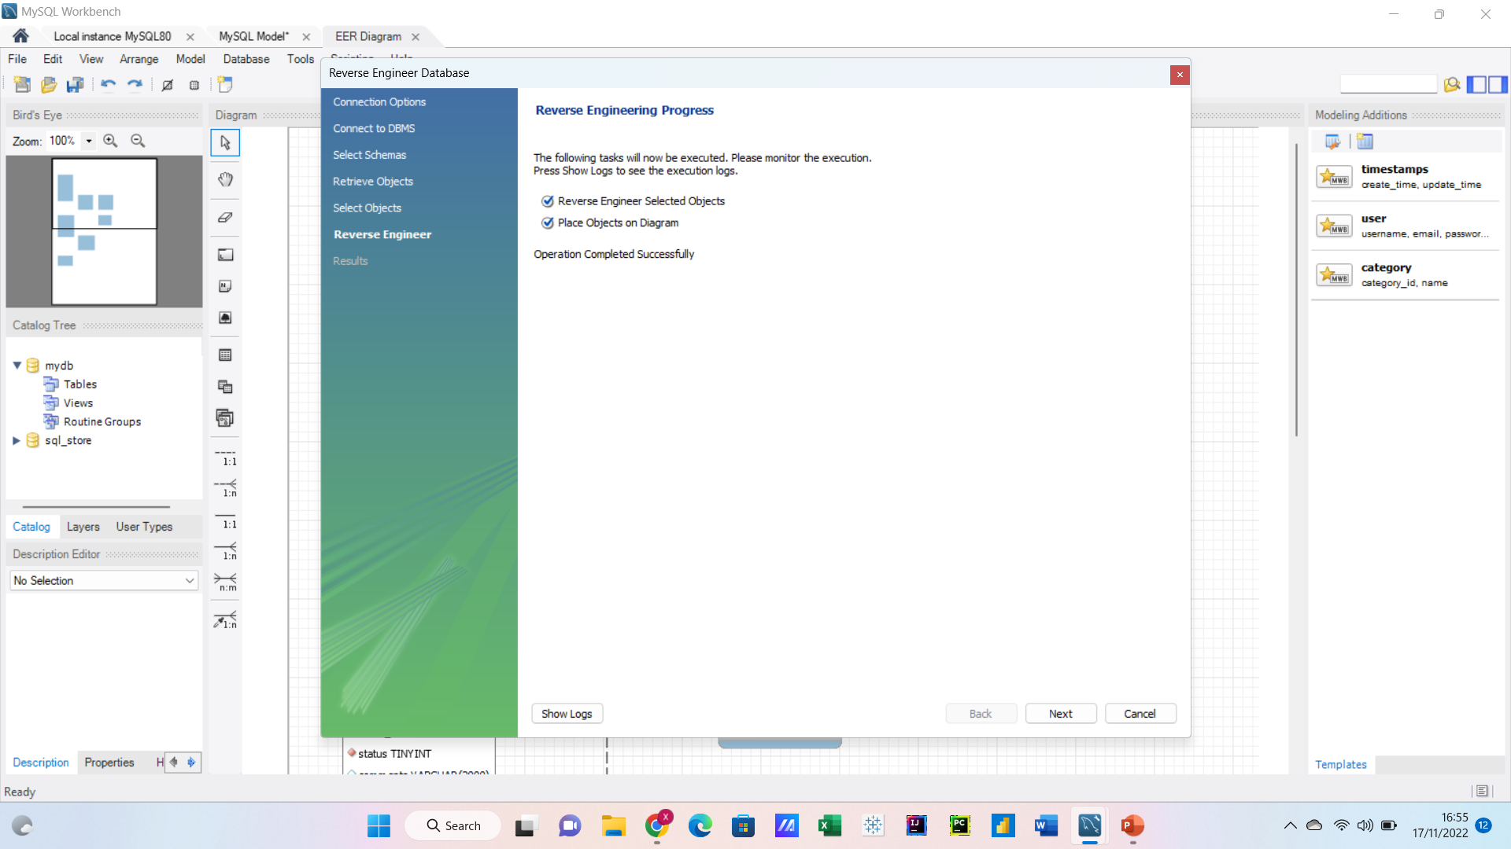
Then we select the right settings for the schema

Slide 19
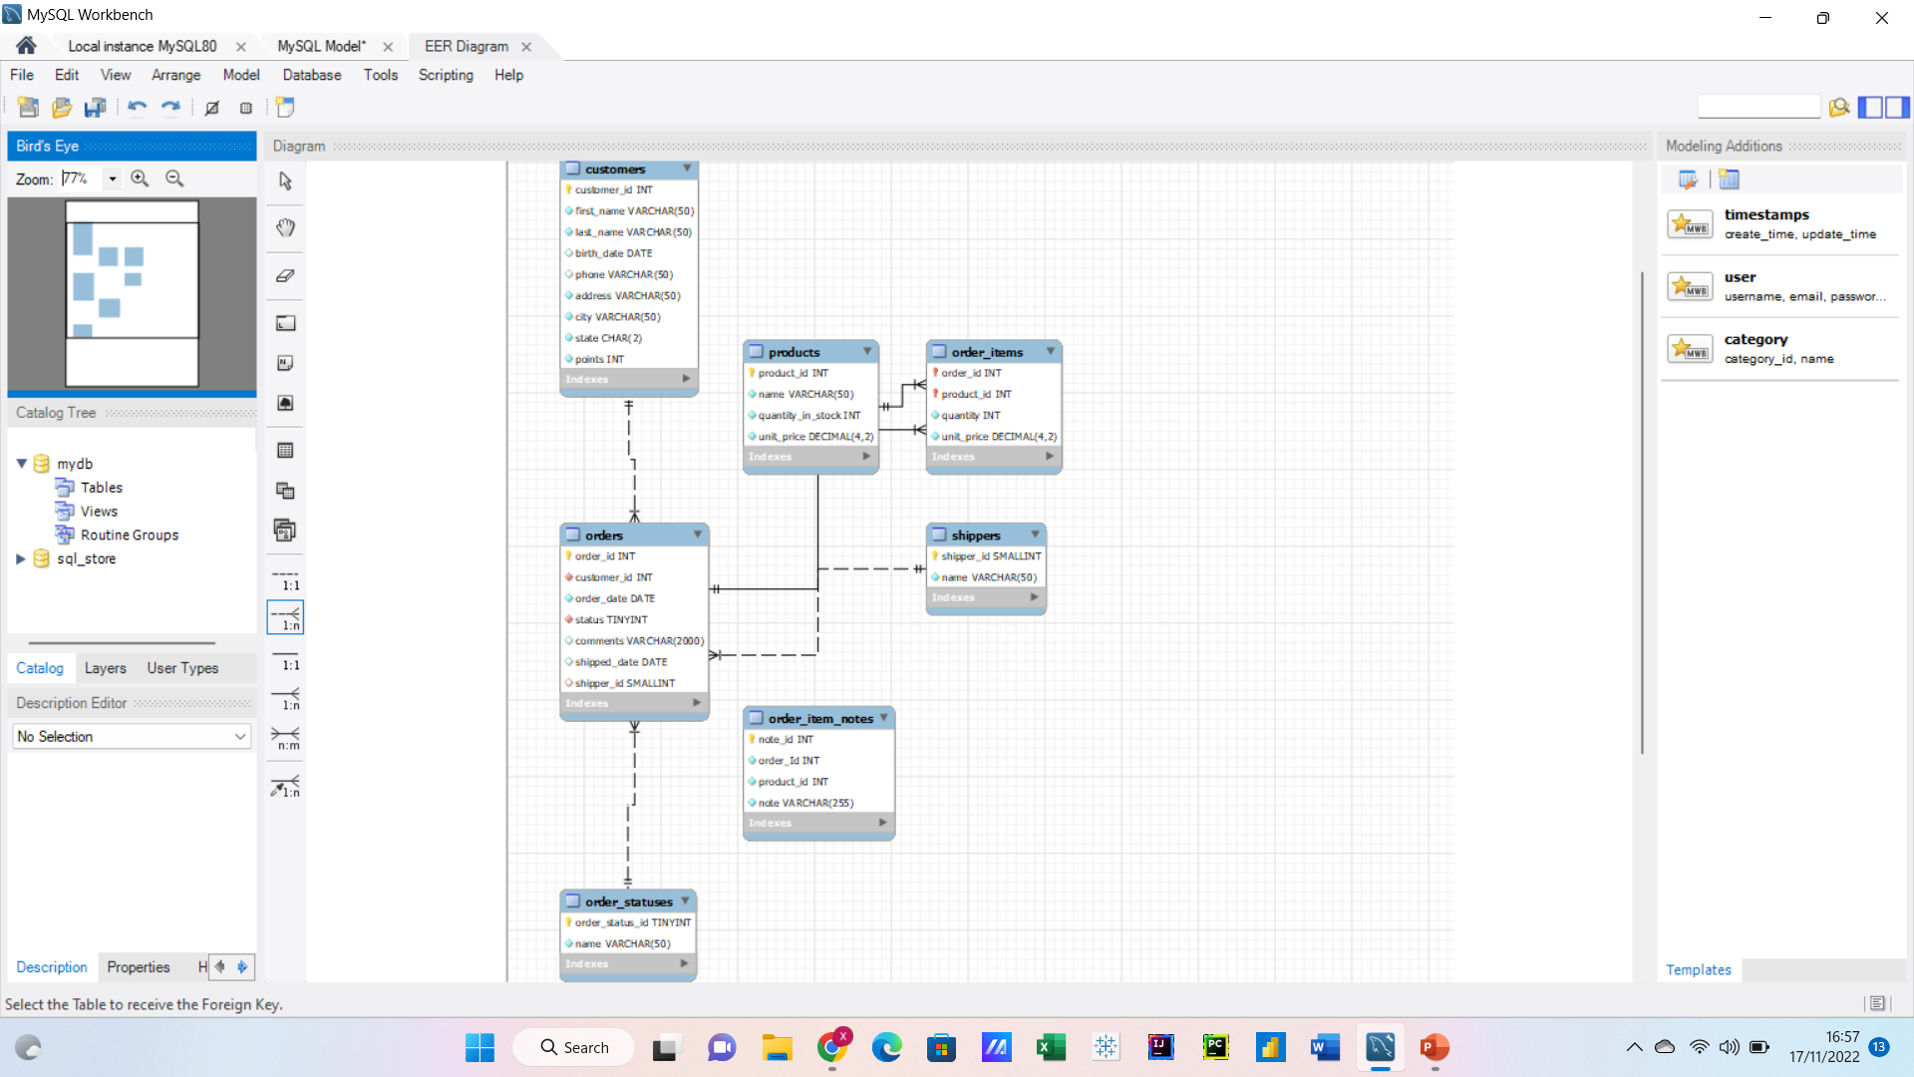
Once the schema has loaded we are giving a basic form of it this is a snow flake schema

Slide 20
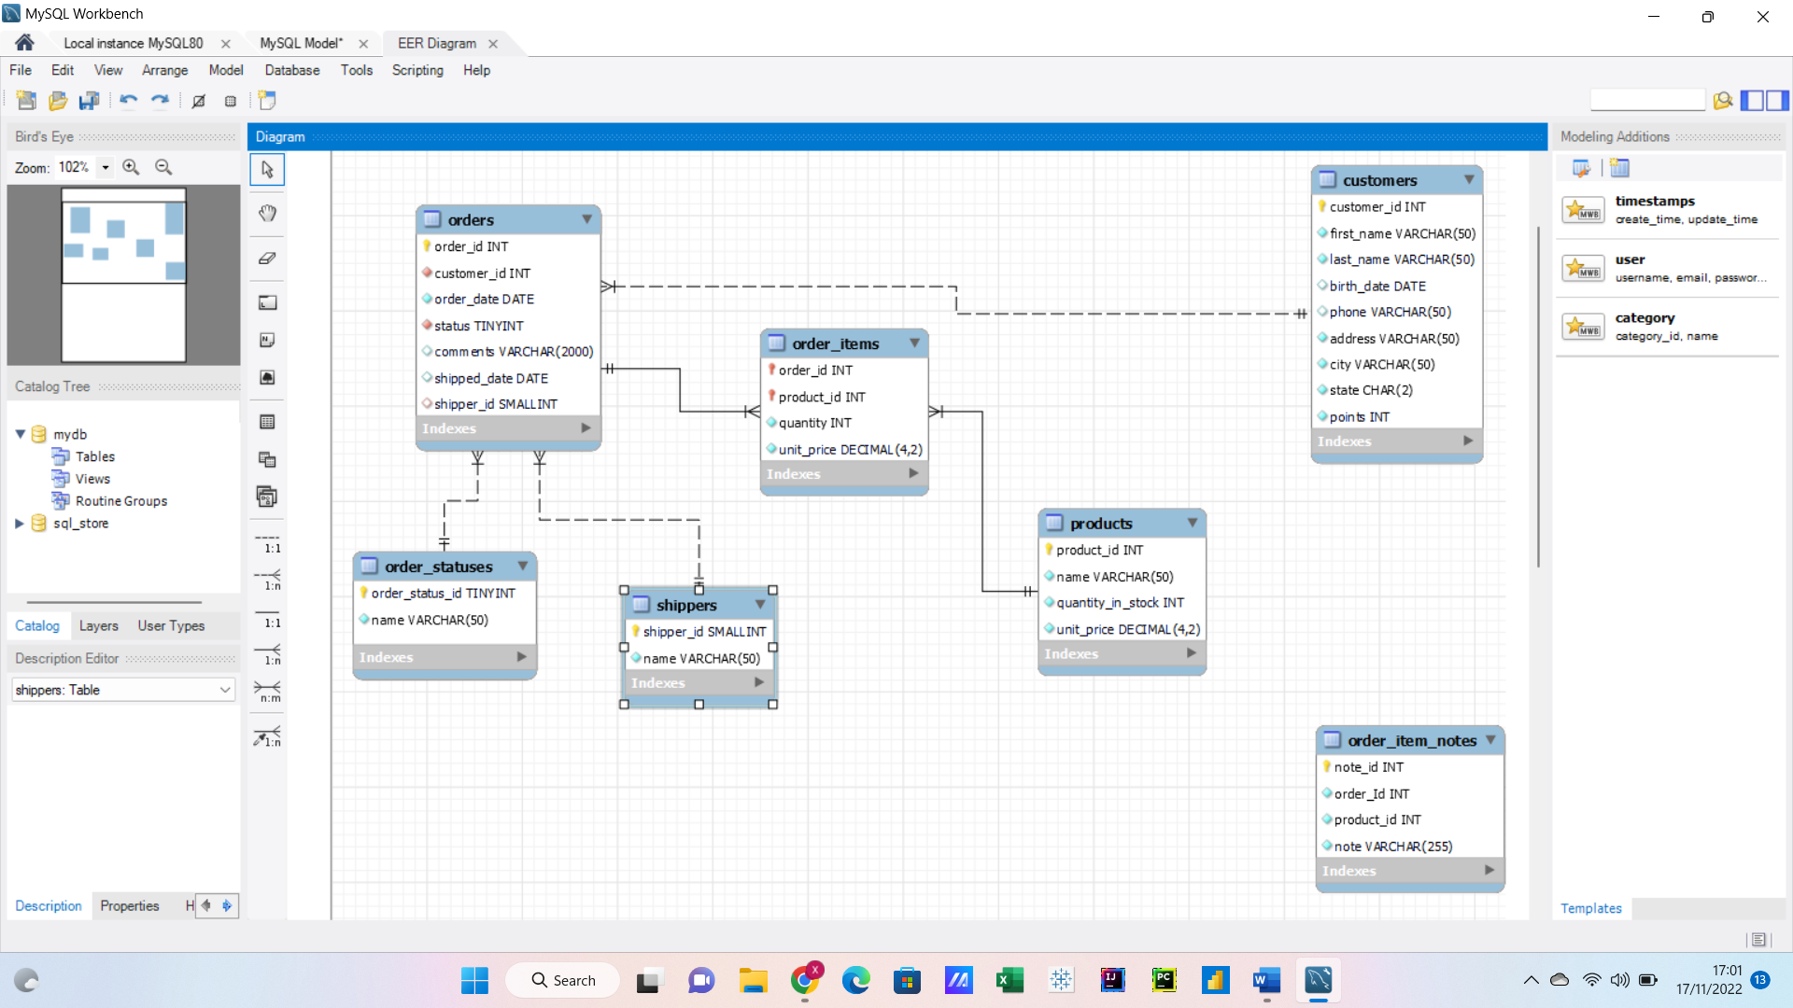
I played around the schema so that it will fit all on to one page

